Slide 1
Implementing Entity Framework with MVC Jump Start
Adam Tuliper | Technical Evangelist, Microsoft
Christopher Harrison | Content Developer, Microsoft

Slide 2

Meet Adam Tuliper | ‏@AdamTuliper
Technical Evangelist, Microsoft
Focused on Web, Data, Gaming, and Cloud Technologies
Emphasis on secure development practices
20 years of industry experience as software architect
Enterprise, startups, public sector, defense, healthcare, financial industries
channel9.msdn.com/Blogs/AdamTuliper
Video content
adamtuliper.com

Slide 3

Meet Christopher Harrison | ‏@geektrainer
Content Developer
Focused on ASP.NET and Office 365 development
Microsoft Certified Trainer
Regular presenter at TechEd
Long time geek
Still misses his Commodore 64
Periodic blogger (blog.geektrainer.com)
Marathoner, husband, father of one four legged child

Slide 4
Course Topics
Implementing Entity Framework with MVC
01 | Introduction to Entity Framework | 04 | Managing the database
02 | Beginning Code First | 05 | Managing transactions
03 | Managing Relationships | 06 | Integrating extra features and looking forward

Slide 5
01 | Introduction to Entity Framework
Adam Tuliper | Technical Evangelist, Microsoft
Christopher Harrison | Content Developer, Microsoft

Slide 6
Module Overview
Architecture
Intro to Code First
Generating EF Classes

Slide 7
Architecture

Slide 8
What is EntityFramework
It IS an ORM
What’s an ORM?
Maps your database types to your code types
Avoids repetitive data access code
Customer
CustomerInfo.cs
Customer
Customer.cs
ShipTo

Slide 9










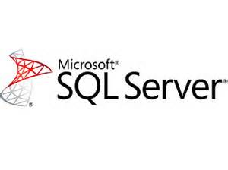



EF Platforms
EF 6.1 Any project that is full .NET 4+
Excluding Windows Phone / Store (see EF7)
Web Forms, MVC, WPF, WCF, Web API, Web Forms
Azure Table Storage, Redis, Mono Mac Linux (EF7)

Slide 10
Some supported features
Full ORM to map objects to code
Async Queries
Connection Resiliency (retry)
Stored Procedure mapping
Reverse engineering existing database
Using code to create database (code first)
Concurrency detection
Enum & Spatial Data support

Slide 11
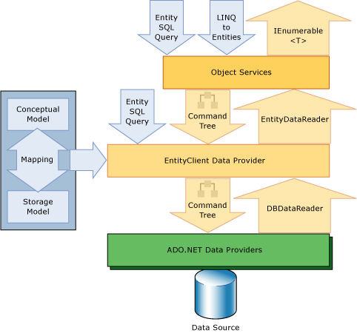
High level view
LINQ to Entities
Convert to query, execute
Map results to entities

Slide 12
Installing Entity Framework
EF6 Requires Visual Studio 2010 or greater
NuGet
Install-package EntityFramework
Comes as part of
MVC, Web Forms, Web API templates if Identity is used

Slide 13
NuGet Primer
Install-Package EntityFramework
Latest non-beta
Install-Package EntityFramework –pre
pre release version
Uninstall-Package EntityFramework
Update-Package EntityFramework –reinstall (all projects)
Update-Package EntityFramework -ProjectName MyProject

Slide 14
Installing and Managing Entity Framework Binaries

Slide 15
Intro to Code First

Slide 16
Code First
The term ‘code first’ – a misnomer?
Allows you to use POCO classes as entities
Uses at a minimum a DbContext and an entity (ie a class)
public class Album
{
public string Name { get; set; }
public decimal Cost{ get; set; }
}
public class MusicStoreDbContext : DbContext
{
public DbSet<Album> Albums{ get; set; }
}

Slide 17
Basic code first and scaffolding

Slide 18
How does EF connect to your db?
Could be cloud, App_Data folder, Intranet, Internet, other folder
Connect string named in DbContext class
Read connect string
Open Connection
You should always specify a connection string name when you intend to use a connection string in the config file. This ensures that if the connection string is not present then Entity Framework will throw rather than creating a new database by convention.
public MusicContext() : base("MusicStoreConnection")
{
}
Use context class name to look for connect string in web.config
Read connect string
Open Connection
No connect string.
Start database checks
Look for SQL Express
Look for (localdb)\\11
Look for (localdb)\\mssqllocaldb

Slide 19
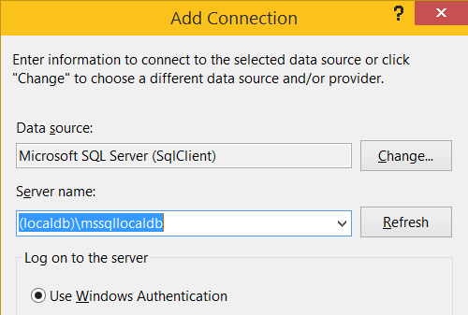
Helpful Hint
Note differences in localdb connection string
Connection string
Data Source=(localdb)\\mssqllocaldb;
In dialog to connect
(localdb)\mssqllocaldb

Slide 20
Viewing queries and connection info

Slide 21
Generating EF classes

Slide 22
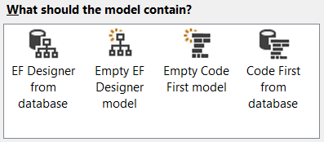
Ways to generate
Hand coding classes
Use a visual designer
Add->ADO.NET Entity Data Model
Database First Entity Designer

Slide 23
Generating database and reverse engineering

Slide 24
Resources
EF Resources
https://msdn.microsoft.com/en-us/data/ef.aspx
EF Team Blog
http://blogs.msdn.com/b/adonet/

